Slide 1
Office 365 Development
July 2014

Slide 2
Course Agenda
Introduction to Office 365 Development
Module 1: Deep Dive Apps for Office in Outlook
Module 2: Deep Dive Apps for Office in Word
Module 3: Deep Dive Apps for Office in PowerPoint
Module 4: Deep Dive Apps for Office in Excel
Module 5: Deep Dive into SharePoint Hosted Apps
Module 6: Deep Dive into Provider Hosted Apps
Module 7: Deep Dive into Security and OAuth
Module 8: App Lifecycle Management

Slide 3
Deep Dive into SharePoint-Hosted Apps
Speaker
Speaker

Slide 4

Agenda
Introduction to Apps for PowerPoint
Developing Apps for PowerPoint
Creating a Video Player
Adding a Web Service

Slide 5
What is an App for Office?
A Web page loaded inside an Office Application
Embedded inline or as task pane within documents, mails or appointments.
Works in both Office Applications and Office Web Applications
Office application extensions using Web technologies
HTML 5 and CSS used to construct user interface
JavaScript and jQuery used to add executable logic and event handlers
App can provided code to read/write content to/from Office documents
App can call Web services hosted over Internet or running within local network
Notes:
An App for Office can be seen as a Web page loaded inside an Office Application. In some cases it will appear embedded inline within the document. In other cases it might appear as a task pane or within a message in Outlook. Note that the architecture for Apps for Office has been designed to work in both Office Applications and Office Web Applications.
WEF and Apps for Office allow Office applications to be extended in such as way so that they can leverage Web technologies such as HTML 5 and CSS for rendering user interface as well as JavaScript and jQuery to add behavior. When you write the JavaScript code for an App for Office, you can call REST APIs such as those added to SharePoint 2013 to retrieve and update data from across network.

Slide 6
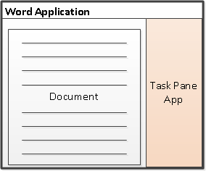
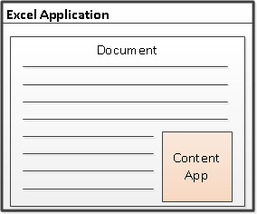
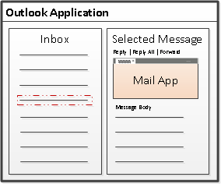
Designing Apps for Office - Shapes
Apps for Office come in three different shapes
Task Pane App (supported by Microsoft PowerPoint)
Content App (supported by Microsoft PowerPoint)
Mail App
Notes:
When you begin to design an app, you must pick one of the three different shapes. You can create a document-based app as either a Task Pane App or a Content App. Alternatively, you can create a Mail App that targets Outlook and Outlook OWA.

Slide 7
App for Office Runtime Environment
Web Extensibility Framework (WEF)
Allows Web page content to render inside Office Application
Allows Web page code to run within a set of constraints
Allows Web page code to interact with Office documents
Allows Web page code to interact with Exchange items
WEF provides runtime environment for Apps for Office
Apps for Office provide basis for a component architecture
Apps for Office provide ability to publish to App Catalogs and/or Office Store
Apps for Office can be deployed in private networks
Notes:
The Web Extensibility Framework (WEF) is a new development platform used to extend Office applications. This platform allows Web page content to render inside Office Application and to interact with Office documents such as Word document and Excel workbooks and Exchange items such as messages and appointments.
The WEF development platform is used to develop Apps for Office. Apps for Office provide basis for a component architecture which allows developers to build apps which target Office application and Office Web applications such as Excel services and Outlook Web Access.
WEF and the Apps for Office development model provide foundation for distribution of apps using an app directory such as the Office Store and the App Corporate Catalog used to deploy apps in private networks.
Throughout the beta cycle of Office 2013, Apps for Office have been given a codename of "Agave". Note that this codename is only intended for the beta cycle and will disappear by RTM when they will just be called "Apps for Office" or a variation thereof.

Slide 8




Anatomy of an App for Office
Each App for Office is based on XML-based manifest
Manifest points to a Web page
Manifest defines the type of the App for Office
Manifest defines which Office applications it supports
Manifest defines required capabilities
App for Office
Catalog Server
Web Server
App for Office
App for Office
Manifest
<XML>
Web
Page
HTML+JS
Notes:
Every App for Office must be distributed with an XML-based manifest which contains information about the app itself. For example, the app manifest contains an address to a Web page on the Internet which is used to load the app. The app manifest also includes information which indicates which Office applications it supports. The app manifest also defines the required capabilities which represent the set of permissions that the app needs in order to run and complete its work.

Slide 9
Developing Apps for PowerPoint

Slide 10
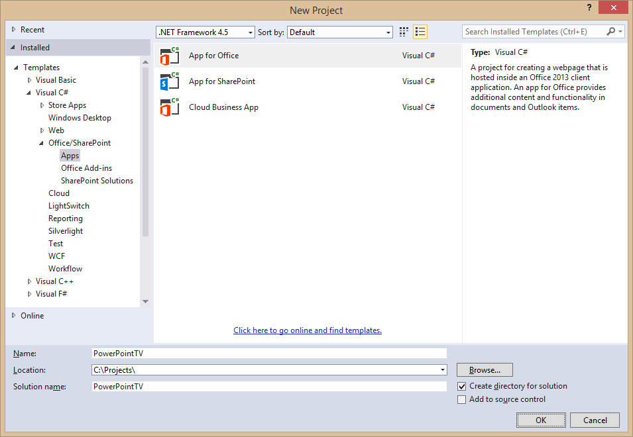
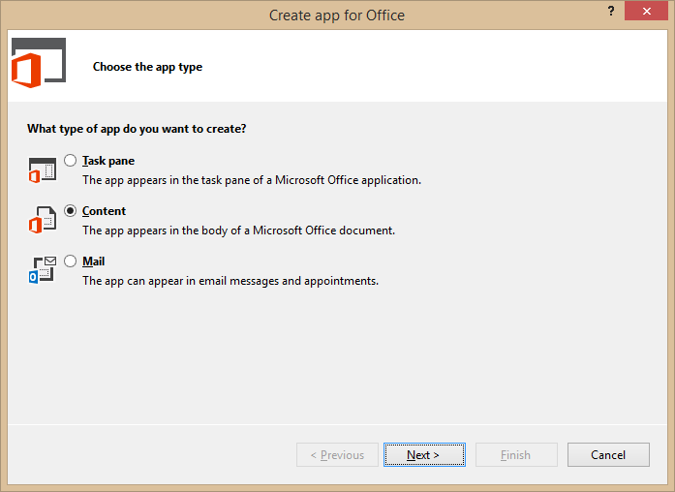
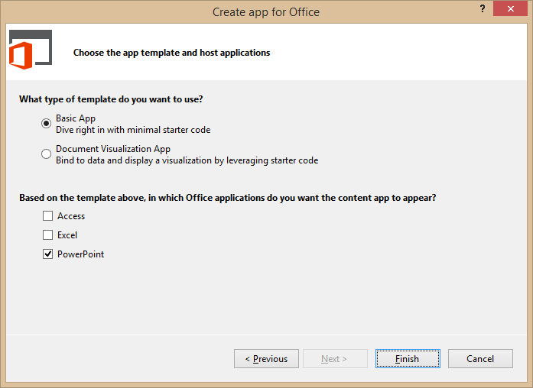
Create New App for Office Project
Create project based on App for Office 2013 project template
Dialogs appear and prompts you for specifics about the app
You must choose (1) the app shape and (2) which Office application are to be supported
Notes:
Visual Studio has a new project template for Apps for Office. These project types gives you a starter project with a web page and manifest.

Slide 11
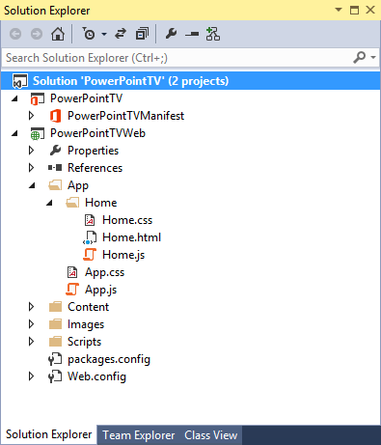
App for Office Project Structure
App for Office solution has two projects
Top project contains app manifest
Bottom project for remote web
Remote Web Project is ASP.NET Website
Contains HTML, CSS and JavaScript source files
Integration with jQuery library already included
Notes:
The slide shows the initial structure of a task pane app created with the Visual Studio 2012.

Slide 12
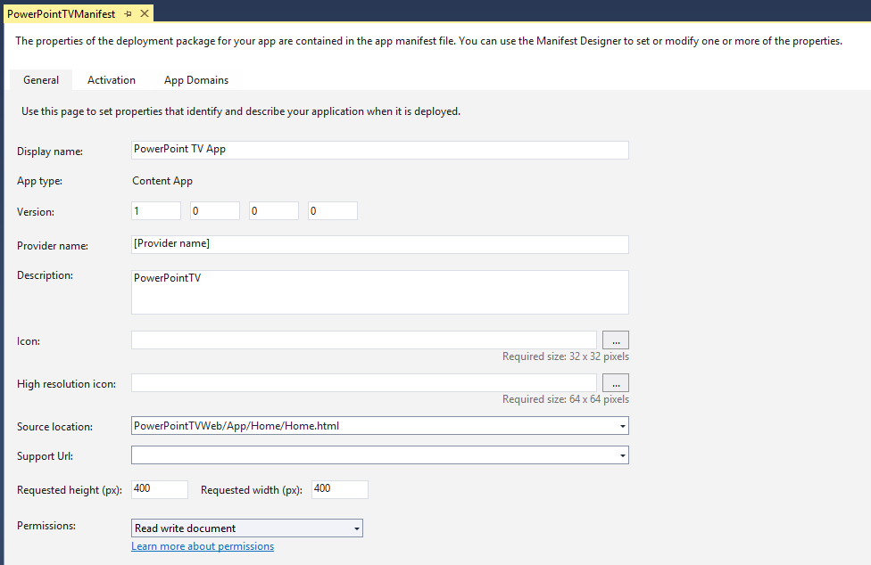
App Manifest Designer
Notes:
This slide shows the Visual Studio designer for an app manifest in a task pane app. It will look different for other types of Apps for Office.

Slide 13
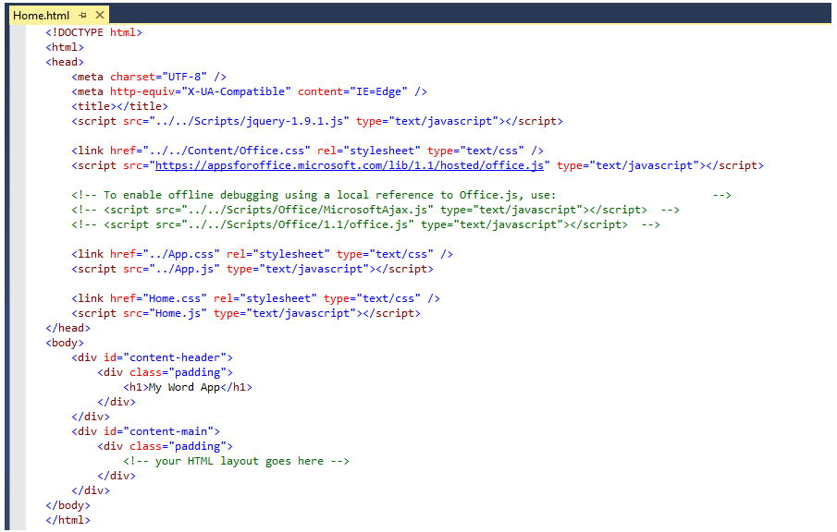
Create the HTML for a Web Page
Notes:
Each app has a source location which points to a entry point Web page somewhere on the Internet. Here is an example of a simple Web page that is used to load a task pane app. Note that this page must link to any required CSS files and JavaScript that will be adding styles or behavior behind the app. Visual Studio automatically adds the links for jQuery and ASP.NET AJAX. Also note that the page adds HTML elements which are often created with ids and/or classes.

Slide 14
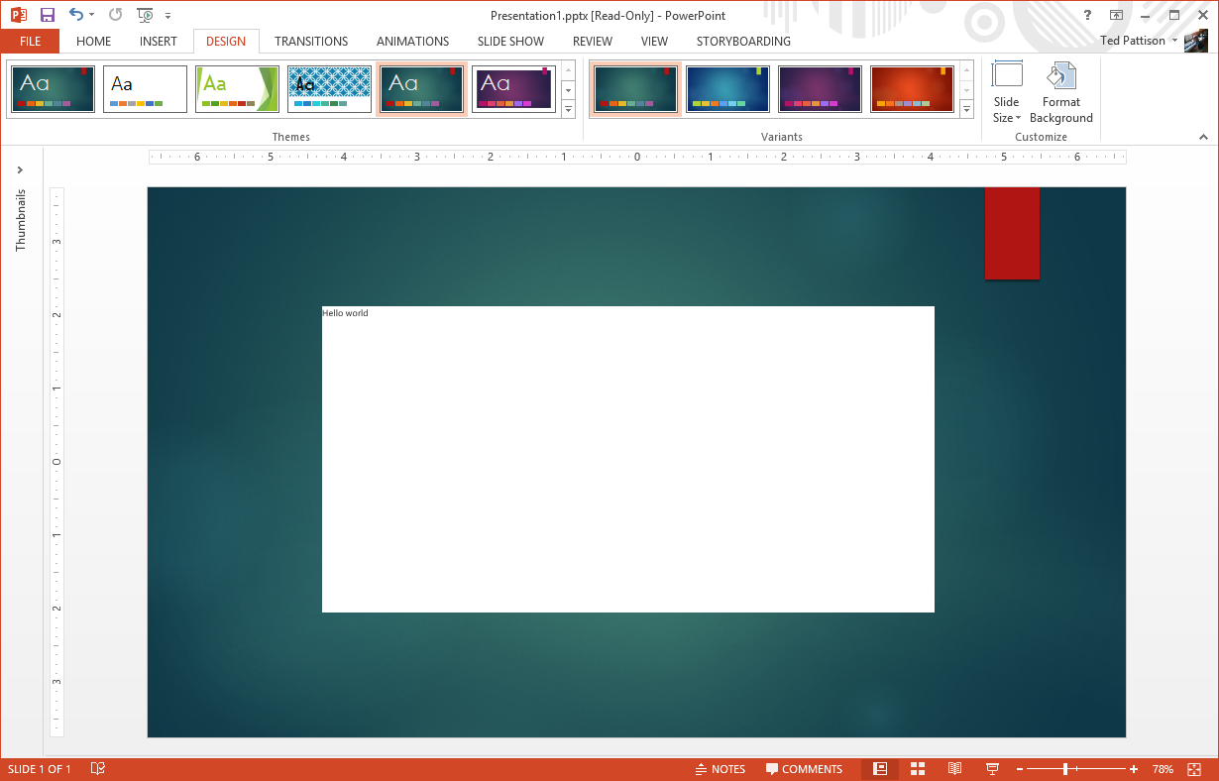
Run Project in Visual Studio Debugger

Slide 15
demo
Creating an Content App for PowerPoint

Slide 16
Creating a Video Player

Slide 17
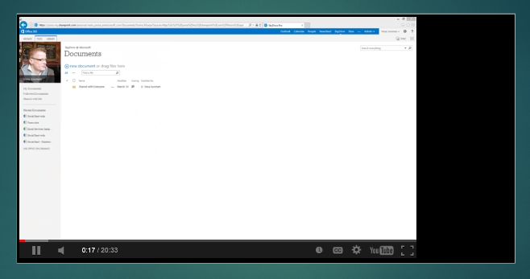
Testing the Player in the Debugger

Slide 18
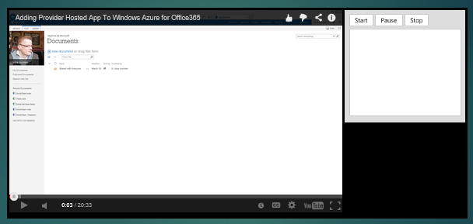
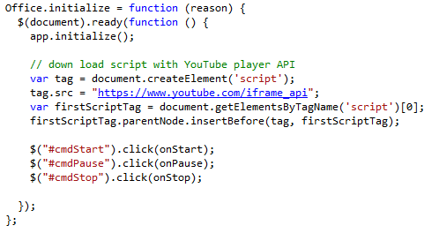
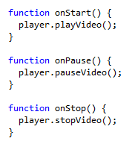
Adding in a Video Control Panel

Slide 19
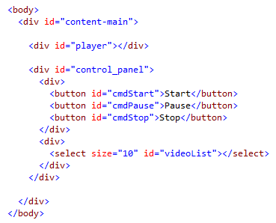
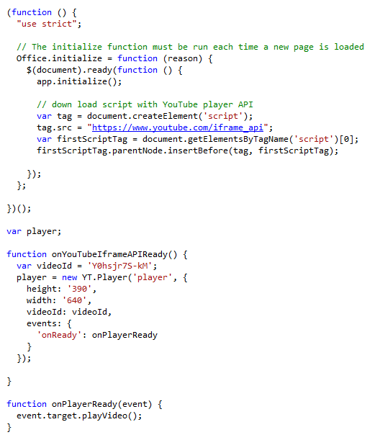
Using the YouTube Player API

Slide 20
demo
Creating a YouTube Video Player

Slide 21
Adding a Web Service

Slide 22
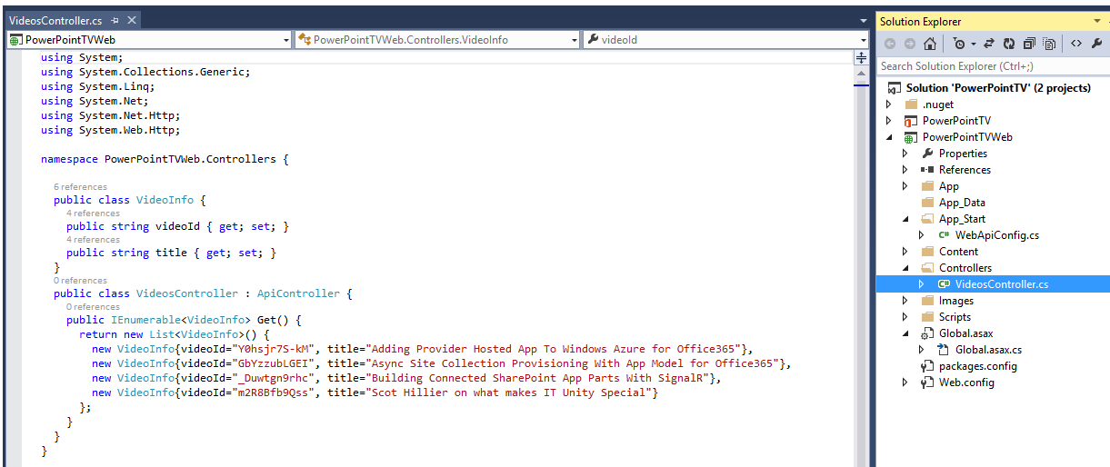
Adding Web Service Support

Slide 23
demo
Adding a Web Service to an App for Office

Slide 24

© 2012 Microsoft Corporation. All rights reserved. Microsoft, Windows, and other product names are or may be registered trademarks and/or trademarks in the U.S. and/or other countries.
The information herein is for informational purposes only and represents the current view of Microsoft Corporation as of the date of this presentation. Because Microsoft must respond to changing market conditions, it should not be interpreted to be a commitment on the part of Microsoft, and Microsoft cannot guarantee the accuracy of any information provided after the date of this presentation. MICROSOFT MAKES NO WARRANTIES, EXPRESS, IMPLIED OR STATUTORY, AS TO THE INFORMATION IN THIS PRESENTATION.

